Slide 1
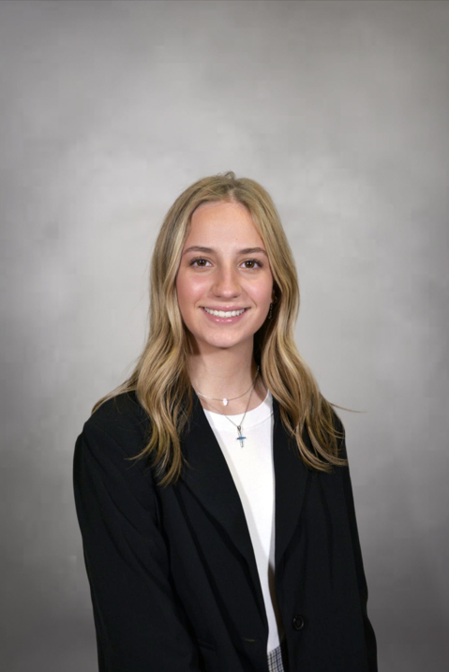
Summer 2026 Internship Presentation
Finance
Lauren Sage

Slide 2
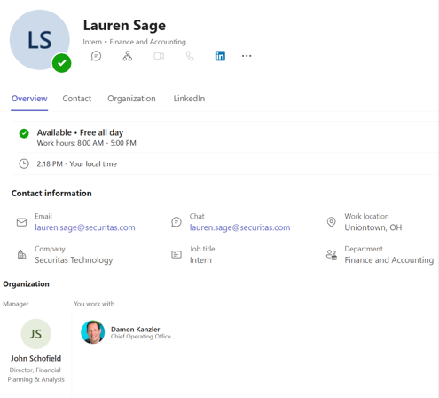

My Position
  Solomon Sub Account Mapping
    Needed for Solomon to SAP Conversion to ensure all active Solomon subaccounts have SAP profit & cost centers
  RMR Backlog Analysis
    Looking for RMR that could be activated
    Clean-up of Solomon RMR backlog for more accurate reporting of RMR backlog
  Install Backlog Analysis
    Provide additional reporting to help the field find jobs that can be pulled forward or scheduled to drive revenue in current month/quarter
  Month End Close/ Presentation work
    To gain a full view of the FP&A process and better understanding of the monthly financial results

Slide 3
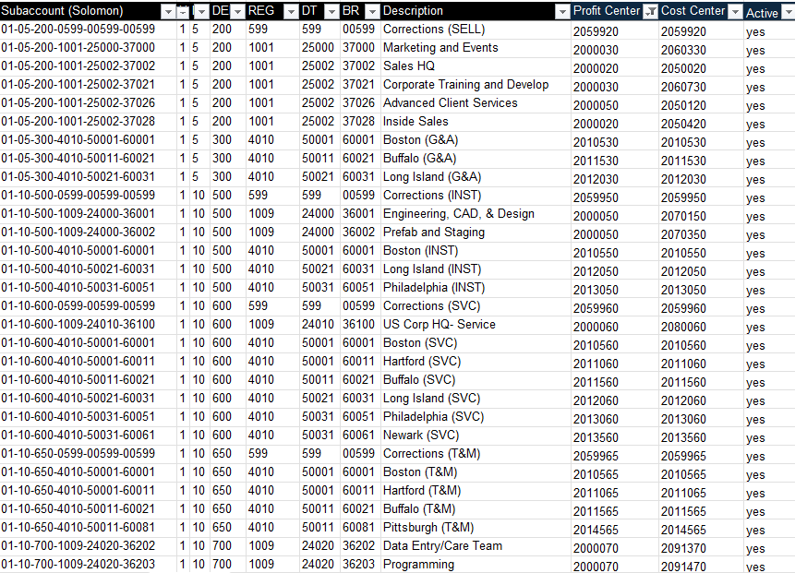
Solomon Sub Account to SAP Cost Center Mapping
Desired Outcome
  Find an SAP profit/cost center match for Solomon subaccount
  Identify what cost centers need created in SAP and which Solomon subaccounts are no longer needed
My Role/Contribution
  Research subaccounts and their current activity
  Used “text to columns” and “lookups” in Excel files to match Solomon subaccounts to SAP cost centers
What was Learned
  Better understanding of Solomon and SAP structure / hierarchies

Slide 4
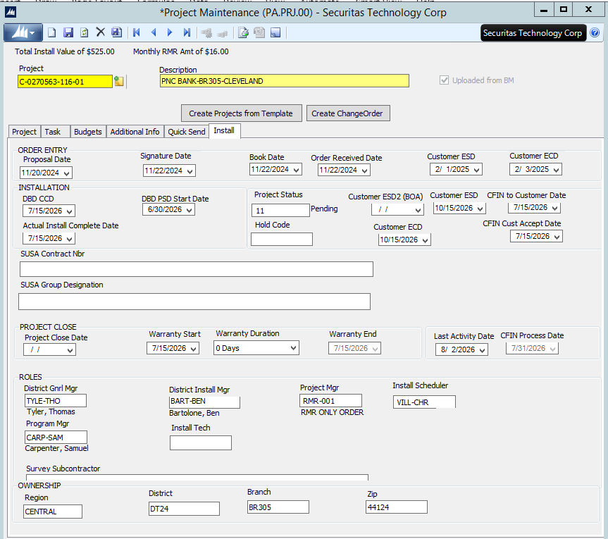
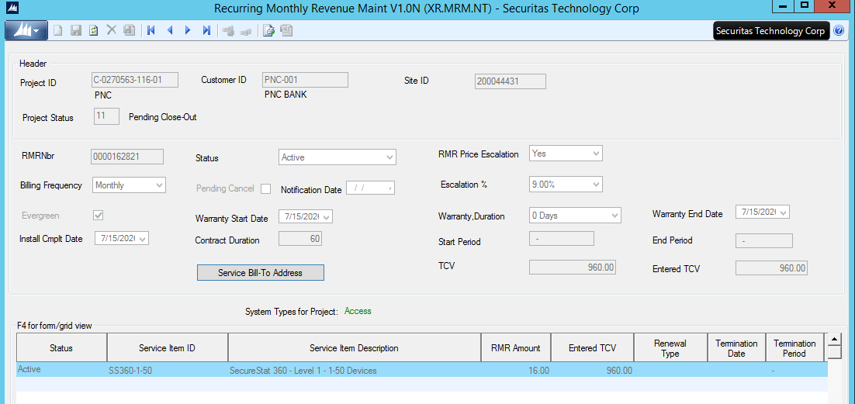
RMR Backlog Project - Contract Backlog Status
Desired Outcome
  Activate RMR where possible
  Remove projects no longer valid
My Role/Contribution
  Conducting research through Solomon on 400+ projects
  4 research items: RMR Only, Status, Dates, RMR Services
  Finding the status and resolution
Preliminary Results
  80 projects activated
  335 projects removed
  10 projects valid status
What was Learned
  A high-level view of the company’s contract process

Slide 5
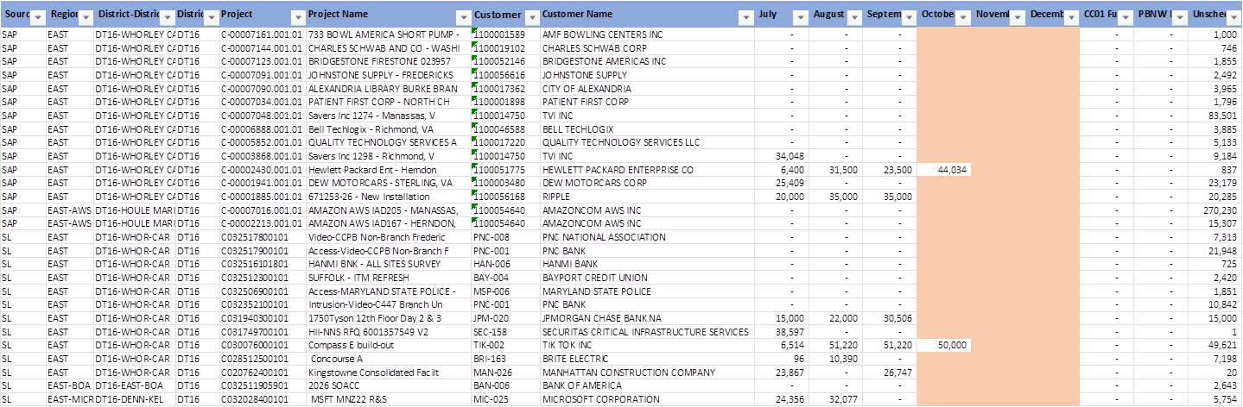
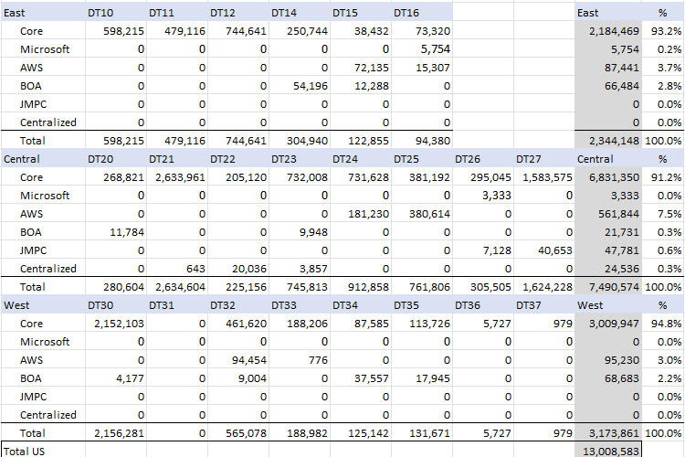
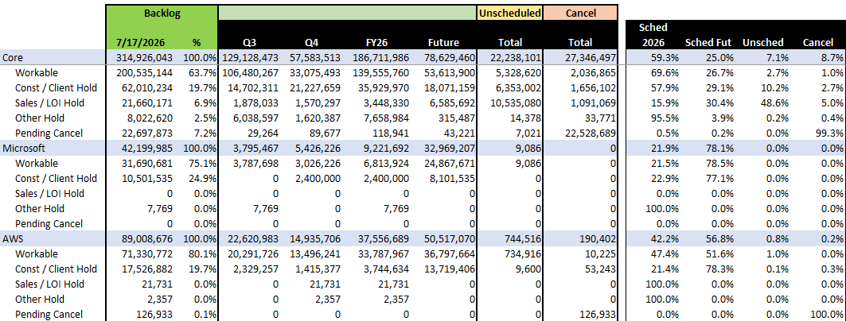
Install Backlog Analysis and Reporting
Desired Outcome
  To pull revenue into the current month or quarter
My Role/Contribution
  Creating files for each district and non-core clients twice a week
  Creating executive summary views of holds, unscheduled, etc.
  Additional reports helped drive a record $83M install revenue in June for US Field
What was Learned
  Better understanding of the install backlog (# of jobs, $ amounts, types of holds)

Slide 6
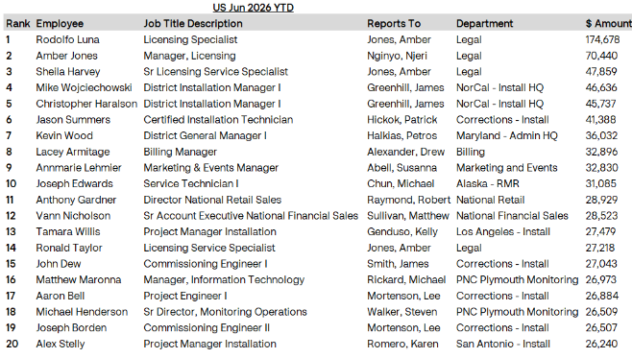
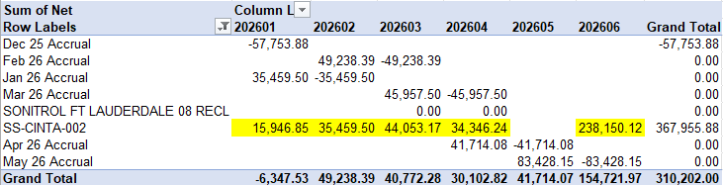
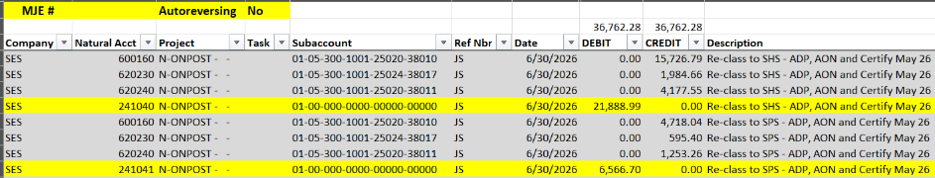
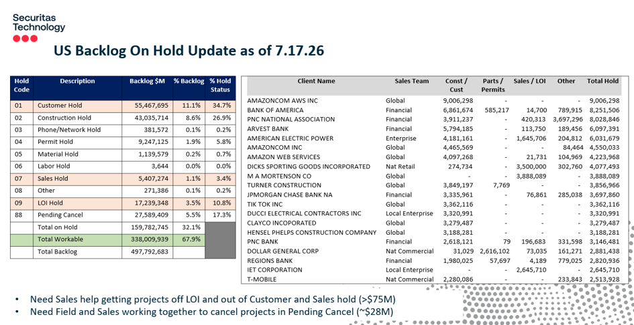
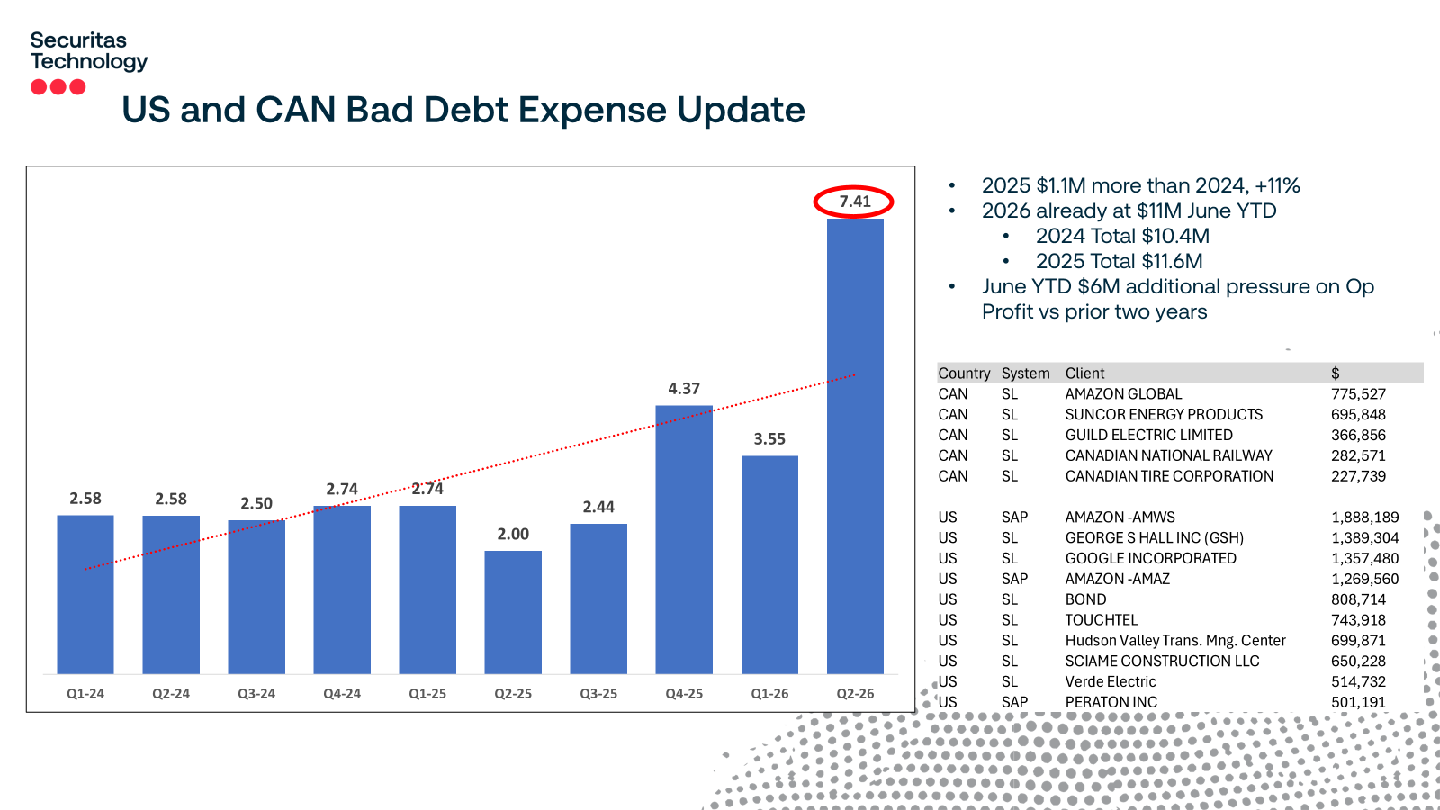
Other – Month End Close & Presentation Work
My Role/Contribution
  Leadership views of corporate credit card spend (total, install, service & sales)
  Create accrual and allocation journal entries (JE’s)
  Reviewed P&L results
What was Learned
  The month end close process & deadlines
  How to create various JE’s
  How to research P&L activity
  All the departments that effect financials
My Role/Contribution
  Created various backlog on-hold slides, T&E slides, Bad Debt slide for Damon’s mid-year slides
What was Learned
  Key focus items during mid-year meetings
  PowerPoint skills
  Bad Debt is a precaution measurement

Slide 7
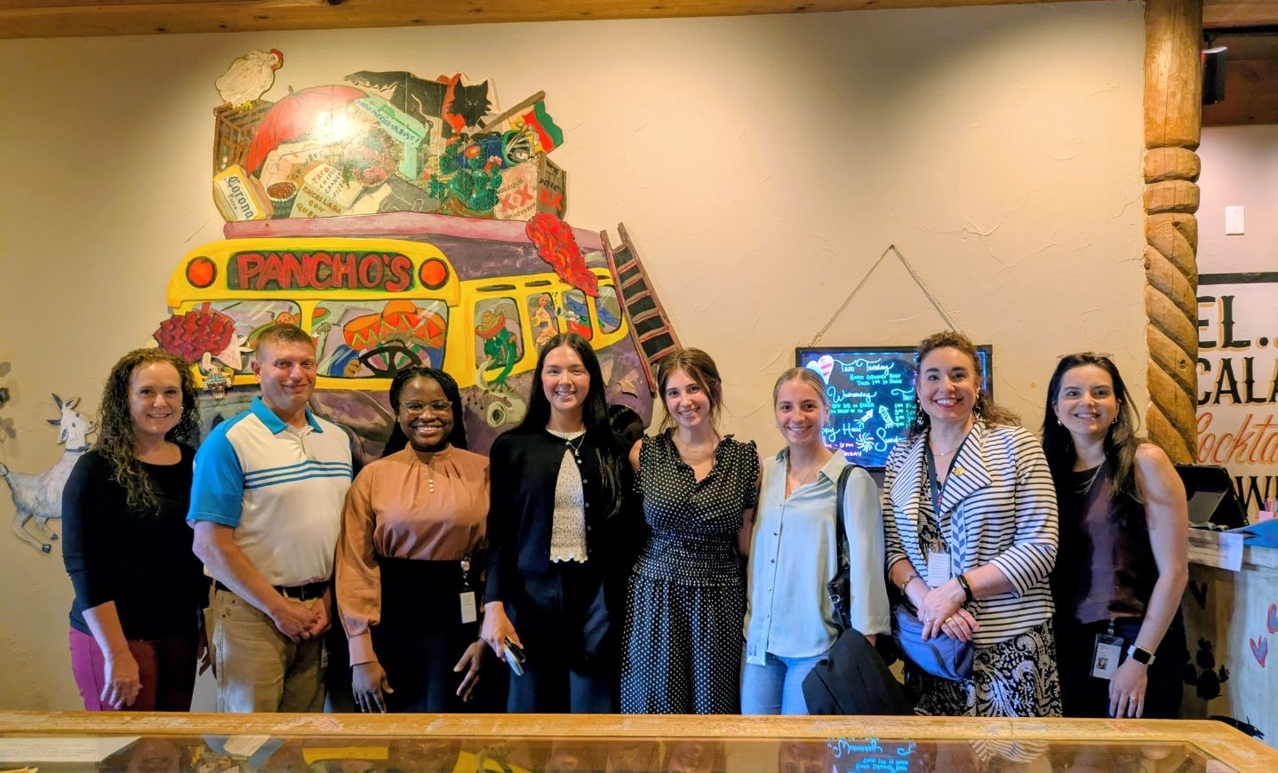
Pros of the Internship
Company involvement/events
Variety in projects and workload
Felt challenged
Gained new skills
Being able to sit in with monitoring
Great mentoring by managers and executives
Getting to learn from each FP&A team member

Slide 8

Suggestions for improvement
More collaboration between other interns and departments
Take more time to observe and learn from other departments
More involvement with company leadership if/when time permits
Preparing for my Future
Helped me navigate my future career and the path I want to take to get there
Able to better my resume and interview talking points
Gained real world work experience within an office setting

Slide 9
Questions?
Thank You

